Slide 1
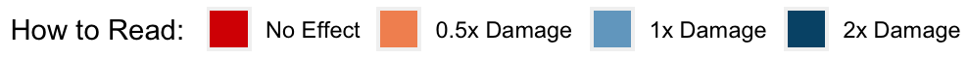
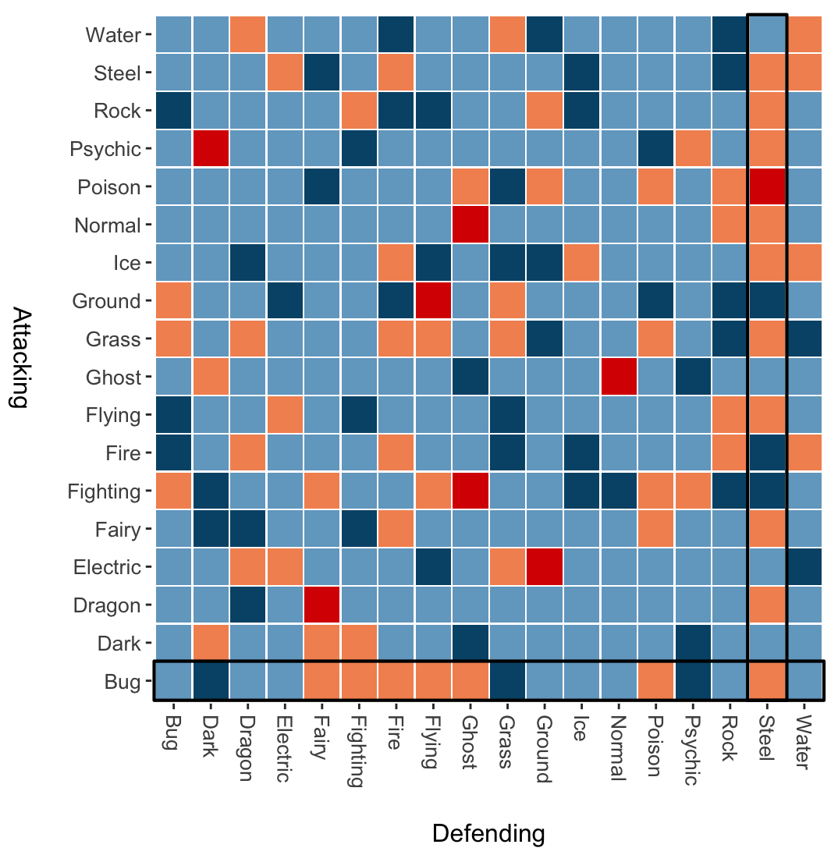
Which Pokémon Attacks are the Most Effective Among Single-Type?
Ghost-type attacks are not effective on Normal-Type Pokémon.
Steel-Type Pokémon appear to withstand most attacks.
Bug-Type Attacks are the least affective across most Pokémon types.
Source: Pokémon Type Calculator
Visualization by Alex Elfering

